Slide 1

ELL Leadership Academy
Karina E. Chapa, M.Ed.
Language Proficiency, Biliteracy
and Cultural Diversity Director
kchapa@esc1.net

Slide 2

Professional Learning Essential Agreements
Be respectful of others
Be an active participant
Take care of your needs
Use electronic devices as learning tools

Slide 3

Leadership: Know Thyself
www.16personalities.com

Slide 4

Edmodo Code: bmnrkb
www.edmodo.com

Slide 5
Session Objectives
Content Objective
Today I will examine how to implement the ELPS in all content areas and how to analyze TELPAS data to guide instruction.
Language Objective
Today I will share (orally and in writing) different ideas on how to linguistically accommodate instruction for ELLs.

Slide 6

ELPS
Anticipation Guide
kahoot.it
create.kahoot.it

Slide 7
Statutory Requirement
19 Texas Administrative Code 74.4 Chapter 74. Curriculum Requirements Subchapter A. Required Curriculum 74.4 English Language Proficiency Standards
Adopted December 2007

Slide 8


ELPS Resources
LIAG and ELPS Instructional Tool

Slide 9
ELPS: How are they organized?
Big Ideas
1. Make Content Comprehensible
2. Develop Academic Language
Big Responsibilities
1. Communicated
2. Sequenced
3. Scaffolded
Student Expectations
1. Listening
2. Speaking
3. Reading
4. Writing
5. Learning Strategies
PLDs (L, S, R, W)
1. Beginning
2. Intermediate
3. Advanced
4. Advanced High

Slide 10
ELPS Mingle!
  Form 12 groups through a “Mingle” activity
  Each group will read one of the assigned areas from the LIAG (see next slide)
  Each group must create a visual representation of the section they read (up to 10 words only)
  Post the chart papers on the wall in clusters (you should have the same amount of clusters as participants per group)
  Assign each participant per group to one of the clusters.
  Give participants 1 minute per poster to present (each cluster should always have an expert – a person who created the posters)
  Rotate clockwise and repeat step 6

Slide 11
ELPS Mingle!
  Listening PLDs
  Listening Expectations & CCRS
  Listening Teacher Behaviors
  Speaking PLDs
  Speaking Expectations & CCRS
  Speaking Teacher Behaviors
  Reading 2-12 PLDs
  Reading Expectations & CCRS
  Reading Teacher Behaviors
  Writing 2-12 PLDs
  Writing Expectations & CCRS
  Writing Teacher Behaviors

Slide 12
HAVE A NICE LUNCH!
11:45-1:00

Slide 13
TELPAS-ELPS Connection
Utilizing TELPAS to Guide Instruction

Slide 14
TEKS vs ELPS
STAAR
TELPAS
T
E
K
S
E
L
P
S

Slide 15
TEKS vs ELPS
Academic Proficiency Language Proficiency
STAAR
TELPAS
TEKS
ELPS
Relating Factor: evaluates/measures

Slide 16
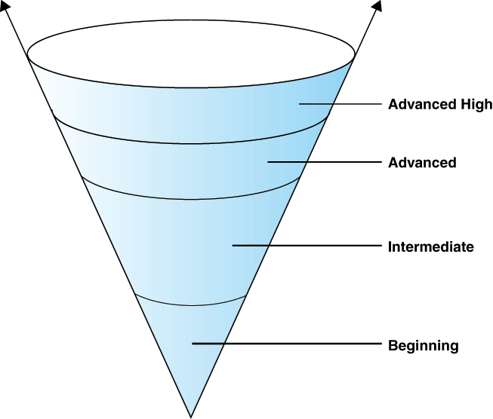
TELPAS Levels

Slide 17
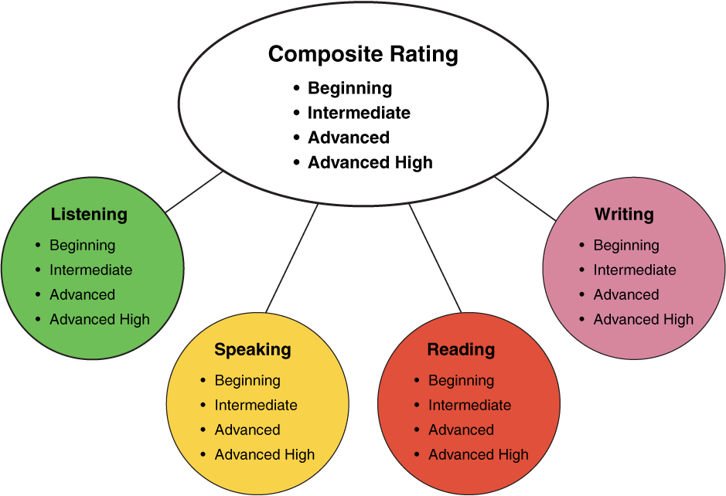
TELPAS Domains
10%
30%
10%
50%

Slide 18
ELPS Resources
LIAG and ELPS Instructional Tool
+
DMAC Reports

Slide 19
DMAC TELPAS Reports
How to Run TELPAS Reports by Language Domain
Go to Home Page
Go to State Assessment
Select TELPAS
Select Instructional Reports
Select Student Language Proficiency Rating
Generate Report

Slide 20
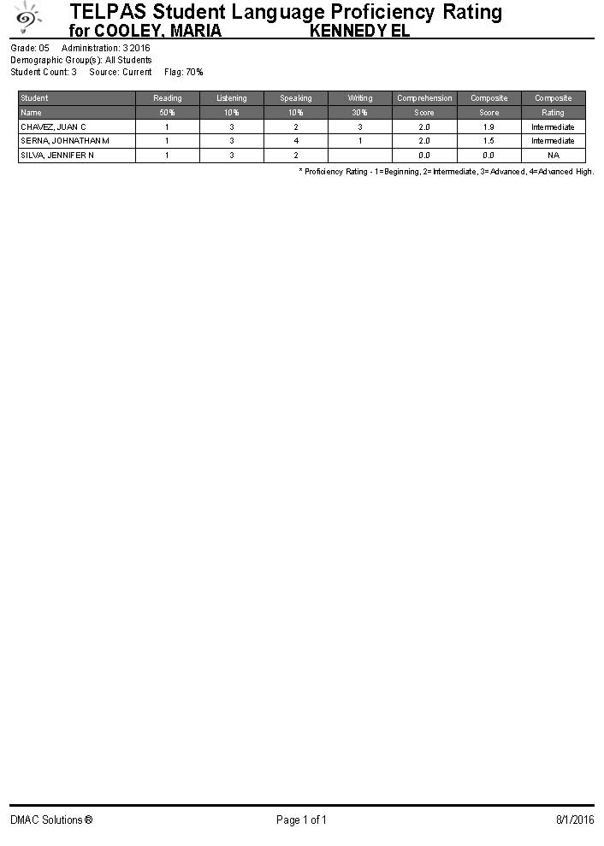
Sample DMAC Report

Slide 21
LPAC Procedures
Instructional Impact

Slide 22

Providing Comprehensible Input
http://programs.esc20.net/default.aspx?name=lpac.resources

Slide 23
LPAC Procedures
Initial Identification Process

Slide 24
LPAC Procedures
Initial Identification Process

Slide 25
ELL Exit Criteria

Slide 27
ELPS for Administrators
Go to: www.texasgateway.com
Sign Up: Create an account
Search: ELPS
Find: ELPS for Administrators
Complete course

Slide 28
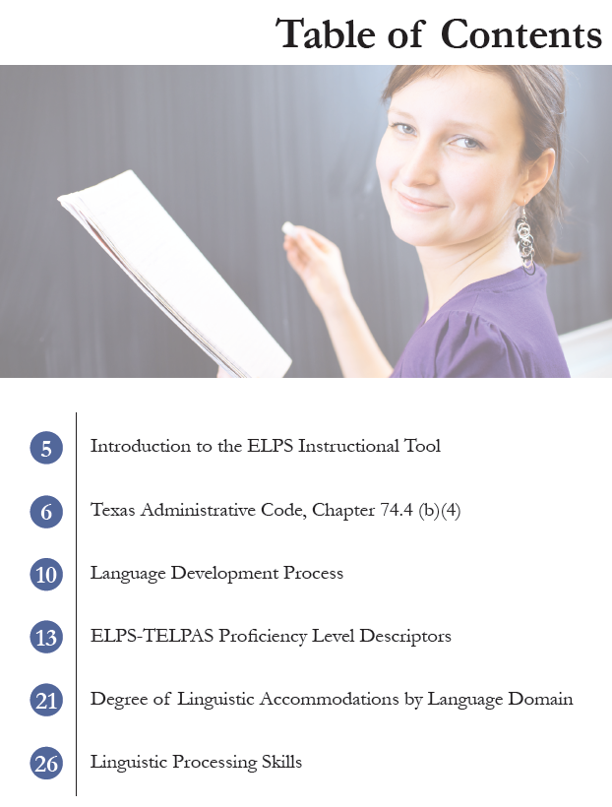
ELPS Instructional Tool
Meeting the needs of beginning and intermediate ELLs

Slide 29
TAC, Chapter 74.4 (b) (4)
… provide intensive ongoing foundational second language acquisition instruction to ELLs in Grade 3 or higher who are at the beginning or intermediate level of English Language proficiency in listening, speaking, reading and/or writing as determined by the state’s English language proficiency assessment system.

Slide 30
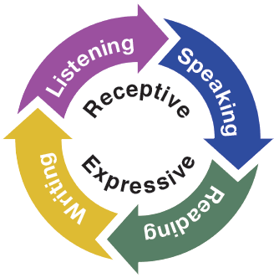
Second Language Acquisition
ELPS Instructional Tool
Instruction must be focused, targeted, and systematic

Slide 31
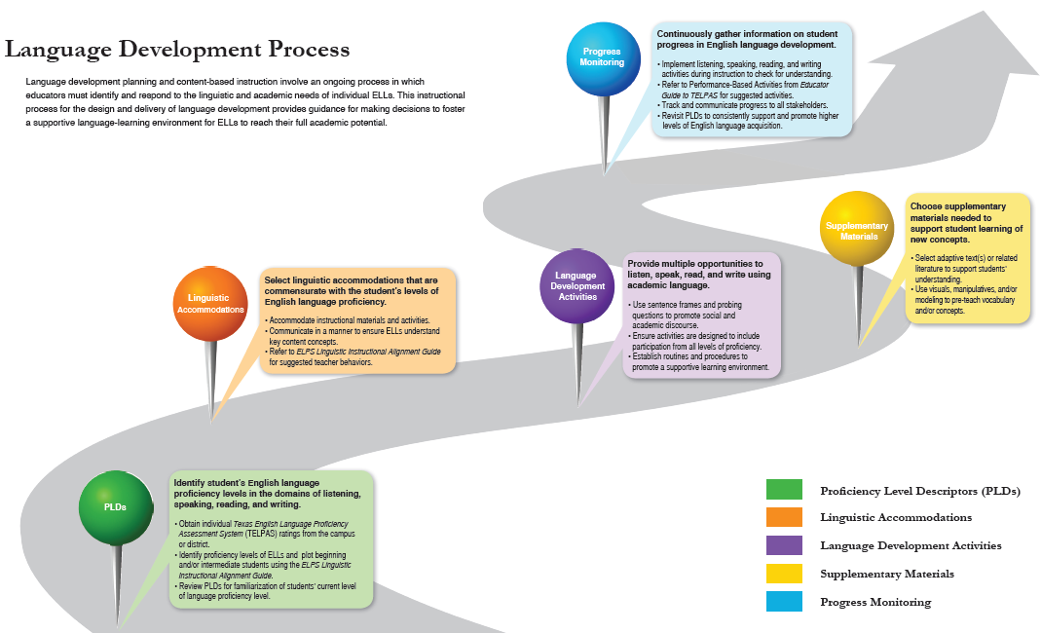
EMOJIS

Slide 32
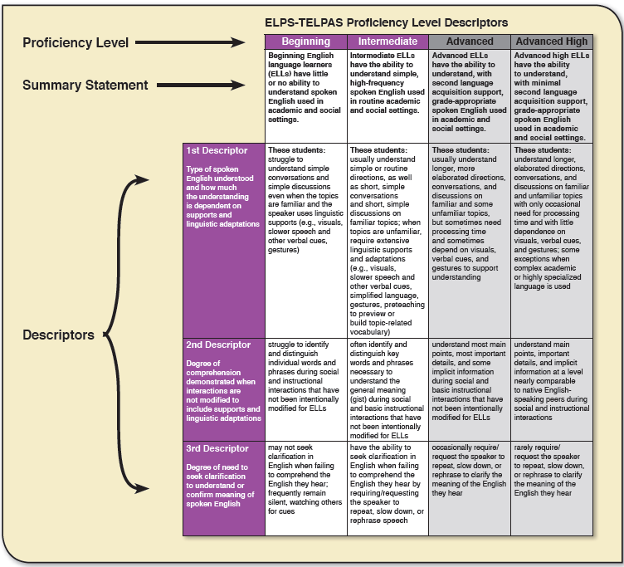
T-Chart

Slide 33
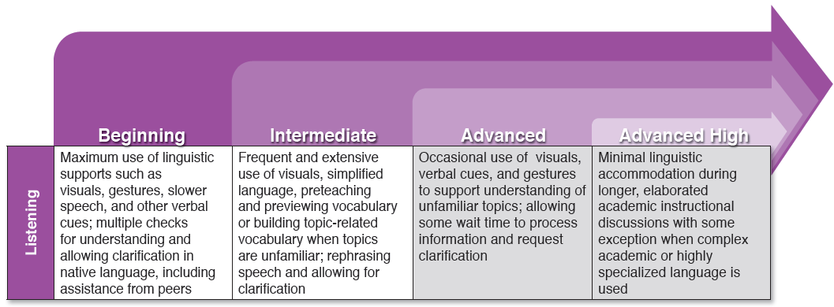
Degree of Linguistic Accommodations by Domain

Slide 34
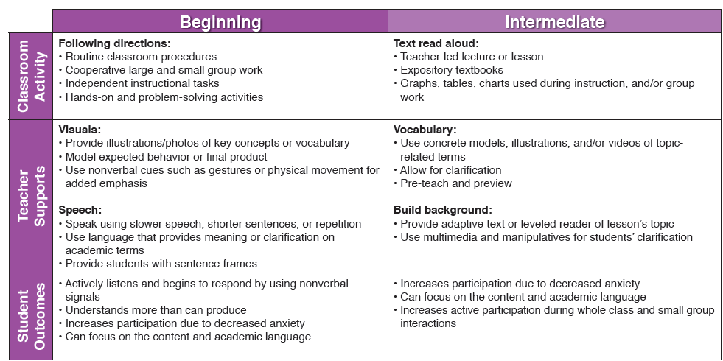
Degree of Linguistic Accommodations by Domain

Slide 35
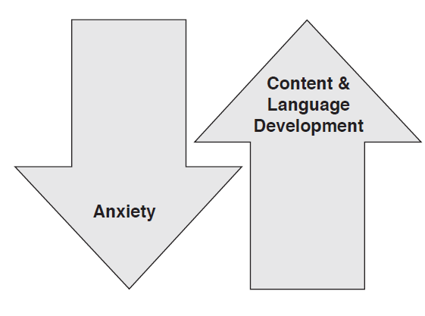
Linguistic Processing Skills
Create a Lesson! Tool, pages 28-33
Sentence frames provide students with the means to receive and express language while reducing their anxiety.
Levels of content and language development will increase as students do not have to contend with context, grammar, and syntax simultaneously.

Slide 36
Tickets Out
I used to think…
But now I know…

Slide 37
Thank you for your participation!
Karina E. Chapa, M.Ed.
Language Proficiency, Biliteracy and Cultural Diversity Director
kchapa@esc1.net
Facebook: Region One ESC Bilingual
Twitter @esc1bilingual

